Slide 1
Simple Appointment Booking Chatbot
By Gopalakrishnan Kumar, MTech IIT-Bombay,
Freelance Data Science Consultant
LinkedIn: Profile Link : https://www.linkedin.com/in/gopalakrishnankumar-a73301110/
Github:https://www.github.com/Gopalakrishnan-Kumar/
Kaggle URL- https://www.kaggle.com/gopalkk2

Slide 2
Google Colab URL
https://colab.research.google.com/drive/1MVYiT79cdcQLNgnZzKJKFxifZ7K6eOsg?usp=sharing

Slide 3
Dataset Overview
Name: appointments.csv
Records: 5
Columns:
Name: Full name of the customer
Date: Date of appointment (YYYY-MM-DD format)
Time: Time of appointment (12-hour format)
Reason: Purpose of the appointment

Slide 4
Dataset Overview
Name | Date | Time | Reason
John Smith | 2025-08-01 | 10:00AM | Dental Check-up
Alice Brown | 2025-08-02 | 02:30PM | Eye Consultation
Mark Taylor | 2025-08-03 | 11:15AM | General Check-up
Rachel Green | 2025-08-04 | 01:00PM | Skin Consultation
David Wong | 2025-08-05 | 04:00PM | Physiotherapy

Slide 5
Chatbot Functionality Overview
The chatbot system is designed to:
Handle appointment queries.
Schedule appointments into a CSV file.
Provide available slots and confirm bookings.
Display appointment schedules on demand.

Slide 6
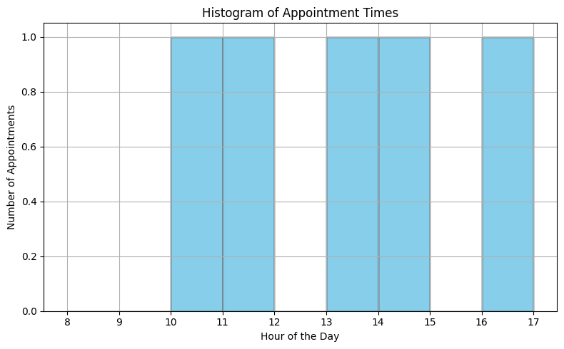
Data Visualization

Slide 7
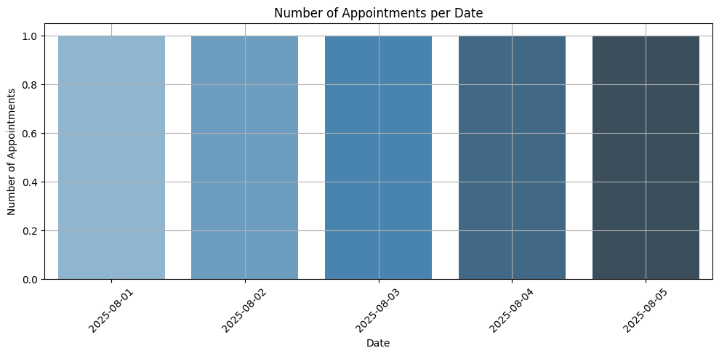
Data Visualization

Slide 8
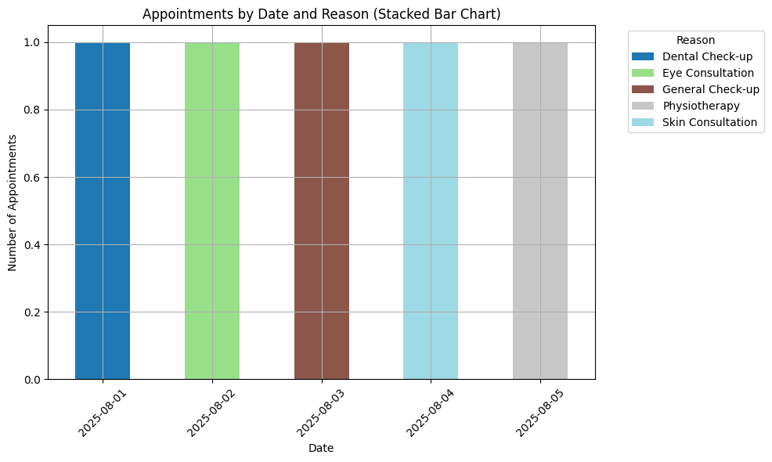
Data Visualization

Slide 9
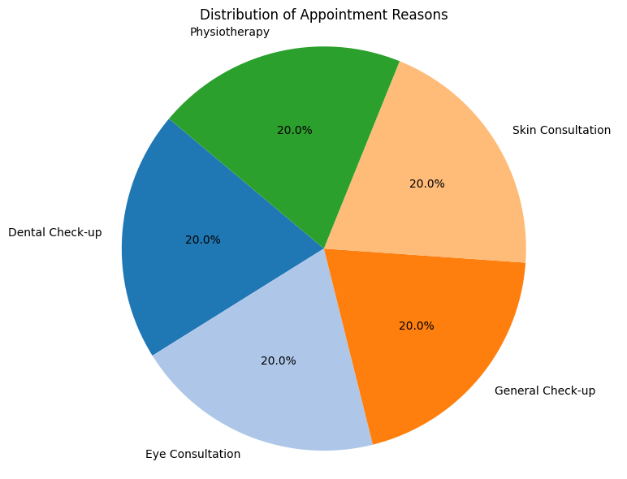
Data Visualization

Slide 10
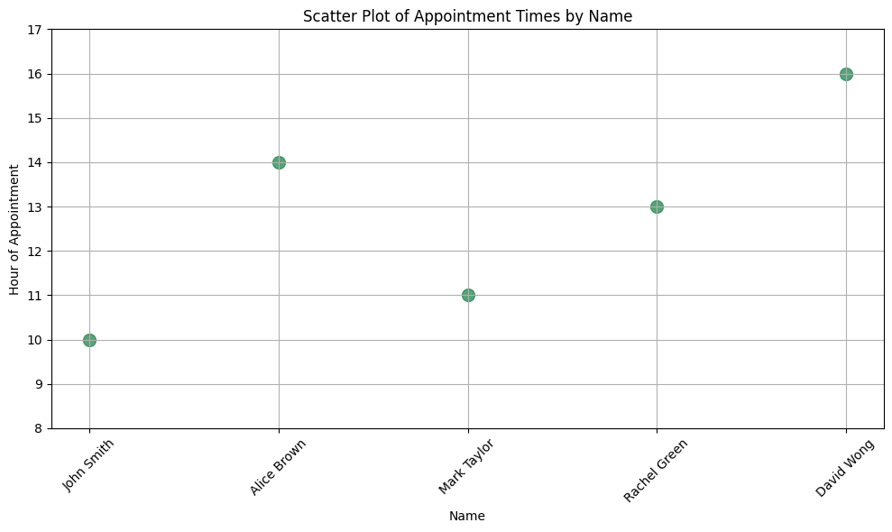
Data Visualization

Slide 11
Suggested Improvement
Add email/phone columns for confirmation.
Validate and restrict booking times to working hours.
Include appointment status (e.g., Confirmed, Cancelled).
Add automated reminders via email/SMS.
Expand chatbot to handle rescheduling and cancellations

Slide 12
Key Benefits
Simplifies appointment management.
Provides quick visibility into schedules.
Can be extended with natural language processing.
Chatbot integrates easily with CSV-based backend.

Slide 13
Next Steps
Add user authentication for multiple agents.
Integrate with calendar APIs (Google Calendar, Outlook).
Enable database storage for scalability.
Deploy chatbot with Streamlit or Flask as a web app.

